Slide 1

The Bottleneck Was Always Human
AI-Assisted Catalog Modeling in Multi-Vendor Networks
Notes:
Nikolina, Engineering Lead at Codaxy

Slide 2
Codaxy
15+ years building telecom software solutions
Creator of CxOrchestrator, TM Forum Gold Certified platform
Supporting Tier 1 & Tier 2 operators globally

Slide 3
Everything starts with the catalog.
Notes:
Network abstraction is the first step in all of our solutions
Network engineers and domain experts come in to design a catalog of TMF resource and service specifications
The development team takes it from there and implements use cases on top of CxO

Slide 4
Everything starts with the catalog.
But the catalog is not the network.
Notes:
This first step was rarely fast
Similar issues surfaced across different implementations
We started looking into it

Slide 5
Network abstraction
project start
delivery
network abstraction
The network engineer new to TMF, learning the framework as they model
No guiding principles yet, the catalog takes shape however makes sense to them

Slide 6
Network abstraction
project start
delivery
network abstraction
development
The catalog made sense to the expert, but the specifications were shaped by what looks good

Slide 7
Network abstraction
project start
delivery
network abstraction
development
The catalog doesn’t work well with workflows
Resource graphs too difficult to reason about at scale

Slide 8
Network abstraction
project start
delivery
network abstraction
development
New use case

Slide 9
Network abstraction
project start
delivery
network abstraction
development
The catalog still doesn’t work well with workflows

Slide 10
So we built a tool

Slide 11
Why not just automate it?
Rules about what makes a catalog good are deeply context-specific
We would also need to encode the domain knowledge, expertise and the wider business context

Slide 12
Because no agent has spent years in the field.

Slide 13
What we actually did
Went back through previous projects to understand:
the business context
the design decisions
the revisions
how the catalog held up

Slide 14
What we actually did
Observed our network engineers at work
Captured the implicit knowledge behind every modeling decision

Slide 15
What we actually did
Identified the design elements that stood the test of time
Specifications grounded in schemas
Relationships governed by protocol connectivity
The lego concept of service composition

Slide 16



Lego concept
IP interface configuration
100G Uplink activation
L3VPN
SOM
catalog
Use case
Service
MPLS
Resource spec
SUBINT
Resource spec
VRF
Resource
spec
BGP
Resource spec
QoS
Resource spec
ACL
Resource spec
ROM
catalog
Resources
mpls ldp
subInterface
Configuration
Templates
Config
accessList
qosPolicy
100G Uplink activation

Slide 17

Lego concept
Use case
IP interface configuration
100G Uplink activation
L3VPN
SOM
catalog
MPLS
Resource spec
SUBINT
Resource spec
VRF
Resource
spec
BGP
Resource spec
QoS
Resource spec
ACL
Resource spec
ROM
catalog
Resources
bgp
vrf
Configuration
Templates
subInterface
Config
accessList
qosPolicy
L3VPN Leg

Slide 18
AI-assisted, expertise-driven catalog modeling

Slide 19

Conversational modeling
The network engineer describes the desired catalog in natural language

Slide 20
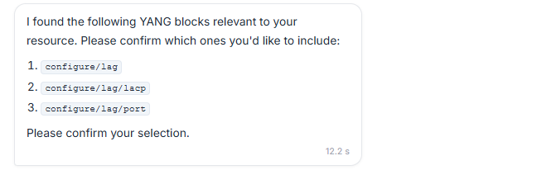
Conversational modeling
The tool explores the schema elements and surfaces those the catalog should be built around

Slide 21
Conversational modeling
The network engineer refines the catalog through conversation

Slide 22
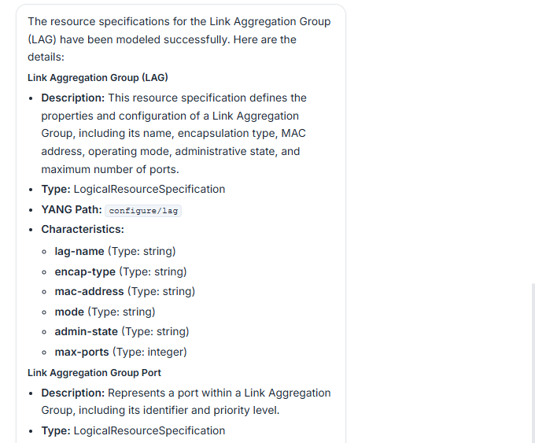
Conversational modeling
The end catalog supports
network discovery
provisioning
config management workflows

Slide 23
The bottleneck was always human.

Slide 24
Faster SME onboarding
TMF concepts and best practices embedded in the process
Experts contribute meaningfully from day one

Slide 25
Reduced catalog refinements
Less back and forth between the network engineer and the development team
The catalog holds up under implementation pressure

Slide 26
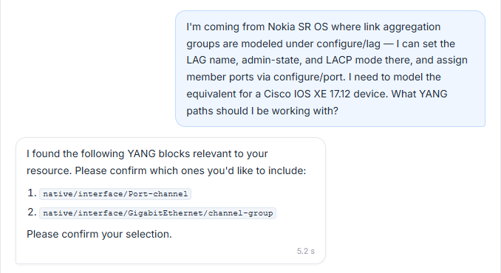
Modeling beyond the primary vendor
The LLM translates concepts and suggests relevant modeling elements across vendors

Slide 27
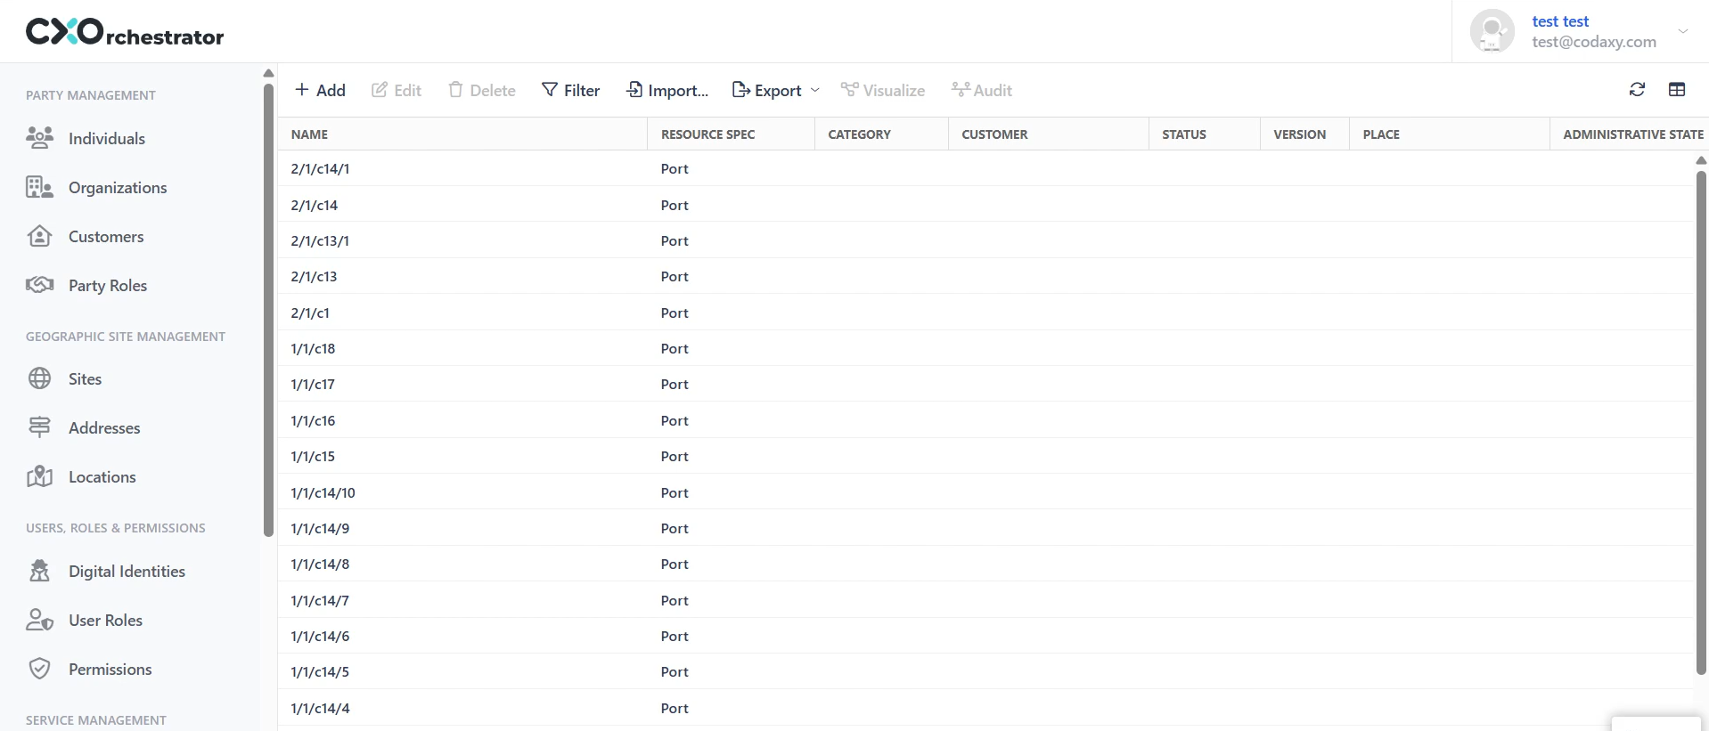
Automated network discovery
Discovery workflow emerges naturally from the catalog
Config extraction via NETCONF, CLI scraping, or config dumps becomes trivial

Slide 28
Instead of automating an entire business process end to end…

Slide 29
…automate the scaffolding around your domain experts.

Slide 30
The bottleneck was always human. So is the solution.

Slide 31
Thank you!

